Slide 1
Redirection

Slide 2

Agenda
Understanding Client side redirection
Understanding ServletContext
Understanding RequestDispatcher
Understanding Server Side Redirection
Difference between include and forward

Slide 3
What is Redirection
Page redirection is generally used when we need to
send the client to a new location
Load balancing

Slide 4
Types of Redirection
Two types of Redirection
Client side
Use request.sendRedirect
Use response.setStatus and response.setHeader
Server side
Use RequestDispatcher
include()
forward()

Slide 5
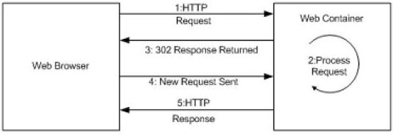
Client Redirection explained
Client make original request for page1
Page1 contains redirecting response
Redirecting response comes to the client
Page1 is not displayed to the client
Without user intervention it request page2
Page2 is ultimately displayed to the client

Slide 6
Understanding ServletContext
Only one ServletContext is created by container
Servlet’s instances can see its environment through ServletContext
It Contains method using which the servlets can communicate
It shares all the information required by the enitre application components(Servlets,JSP)

Slide 7
Understanding RequestDispatcher
RequestDispatcher Object forwards a client request to a resource or include resource itself in response back to the client.
Resource can be
Servlet
JSP
HTML

Slide 8
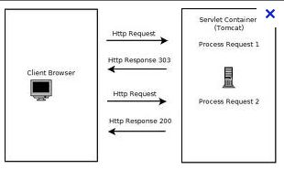
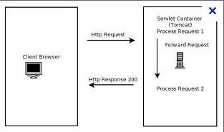
sendRedirect vs RequestDispatcher

Slide 9
Understanding RequestDispatcher

Slide 10
Understanding RequestDispatcher
RequestDispatcher can be created from
ServletContext
ServletRequest
Absolute URL can be specified only when RequestDispatcher invoked from ServletRequest

Slide 11
Difference between include and forward
Forward
Control is transferred to the new page
The output of the current page is not rendered
Include
Control is retained in the current page
The output of the current page is rendered along with the new page

Slide 12
Status Codes
response.setStatus(int statusCode)
Use a constant for the code, not an explicit int.
Constants are in HttpServletResponse
Names derived from standard message.
E.g., SC_OK, SC_NOT_FOUND, etc.
response.sendError(int code,String message)
Wraps message inside small HTML document
response.sendRedirect(String url)
Sets status code to 302
Sets Location response header also

Slide 13

Summary
Response.sendRedirect does client side redirection
RequestDispatcher does Server Side redirection
Include will retain the control in the old page
Forward will transfer control to the new page

